Slide 1

CS 533 INTRO TO DATA SCIENCE
Michael Ekstrand

Slide 2
CONFUSION AND ACCURACY

Slide 3
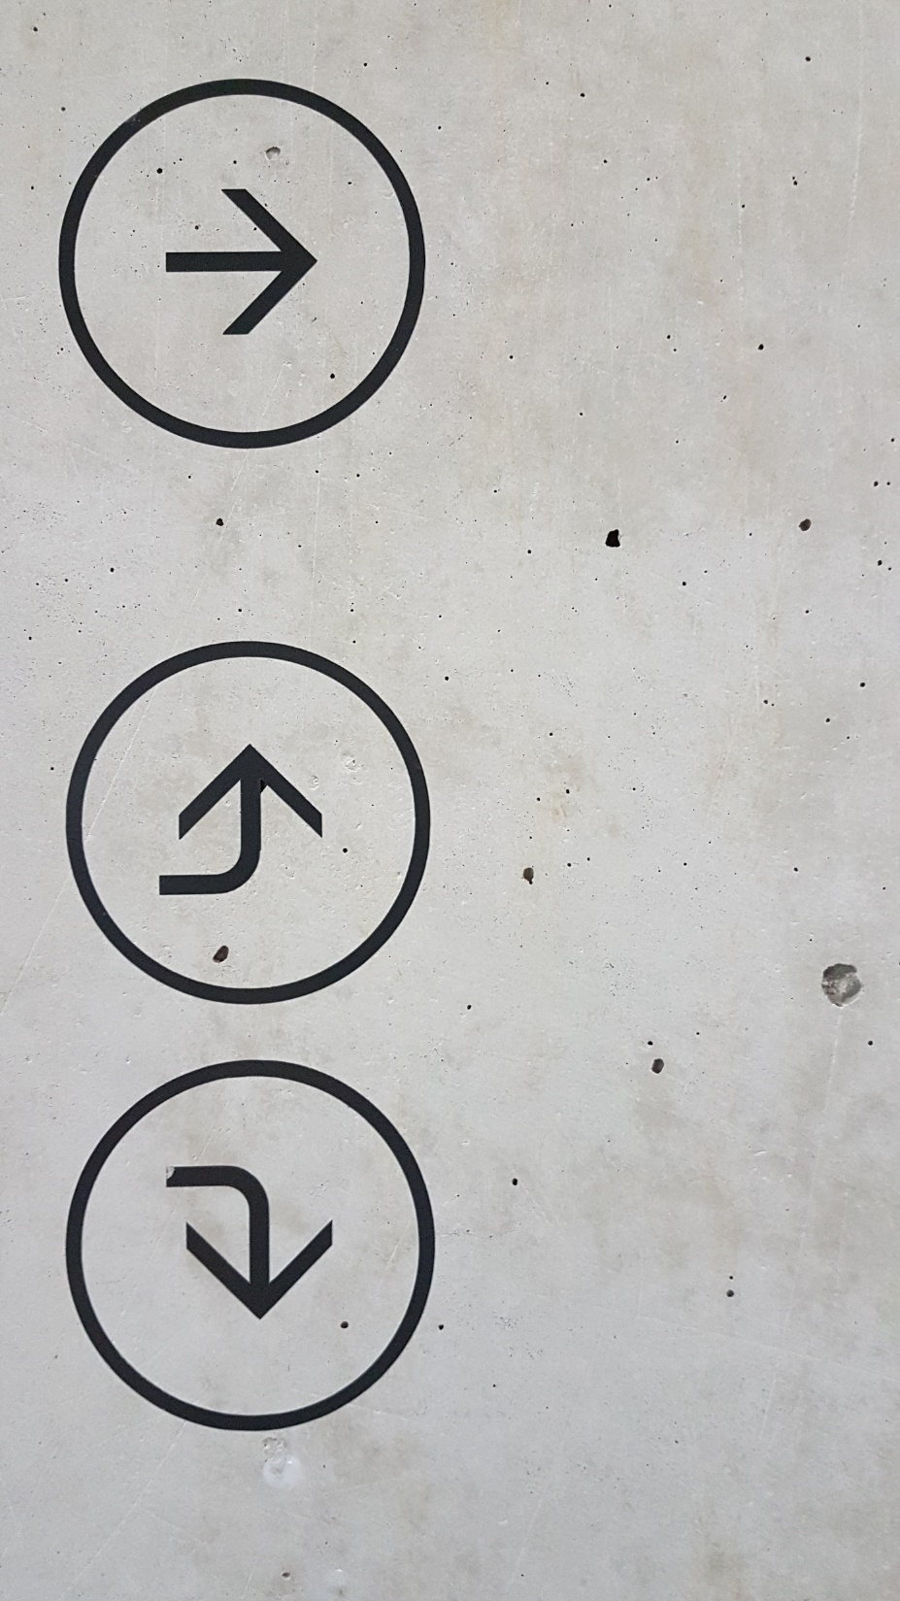
Learning Outcomes
Count true and false positives and negatives
Understand the confusion matrix
Compute precision, recall, and accuracy
Photo by marianne bos on Unsplash

Slide 4
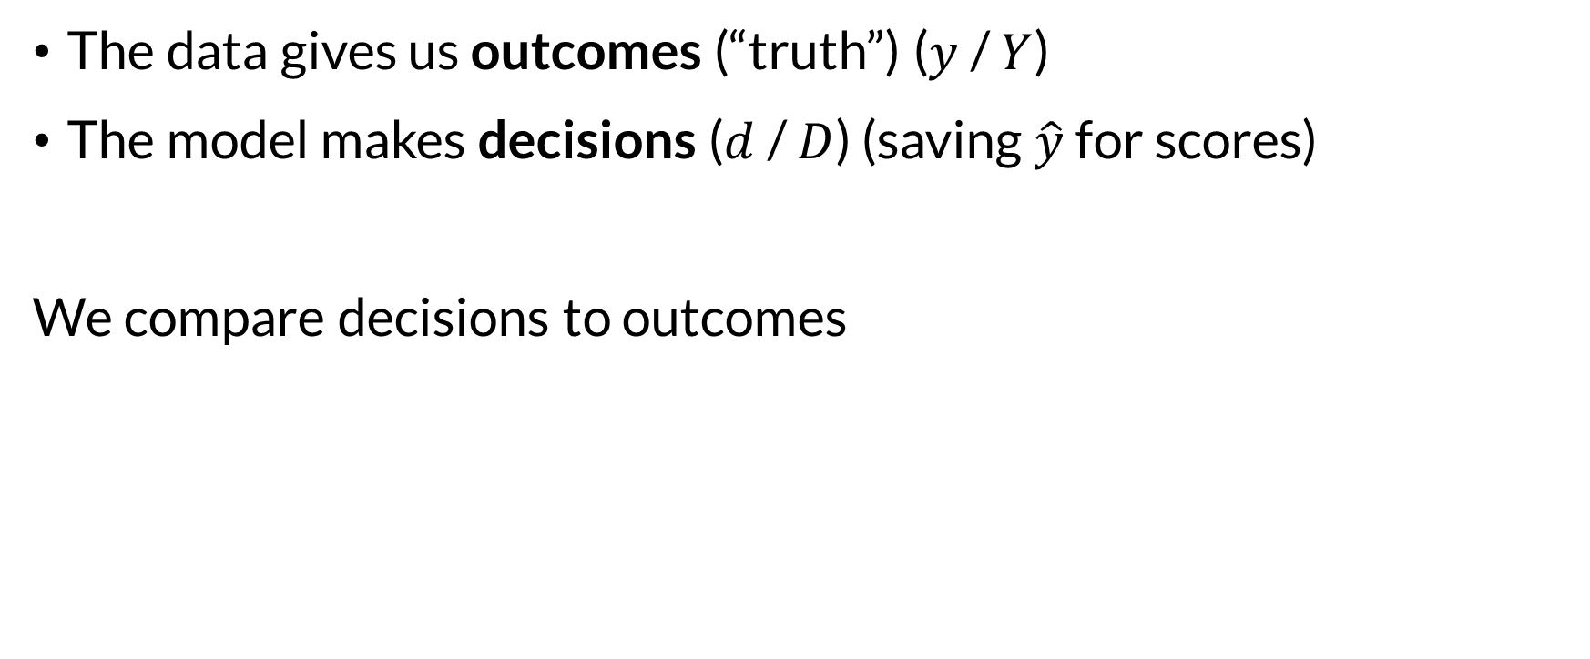

Decisions and Outcomes
The data gives us outcomes (“truth”) ($y$ / $Y$)
The model makes decisions ($d$ / $D$) (saving $\hat{y}$ for scores)
We compare decisions to outcomes

Slide 5
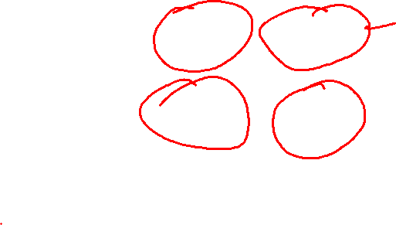
Confusion Matrix
True positives & negatives — correct decisions.
False positive — incorrectly decide yes
False negative — incorrectly decide no
Truth
1
0
Decision
1
True Positive
False Positive
0
False Negative
True Negative

Slide 6
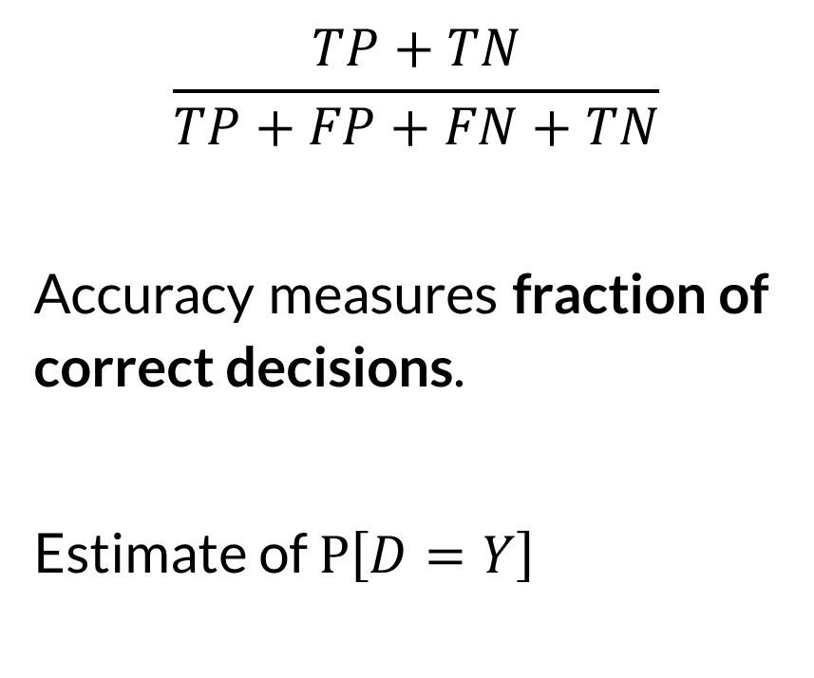
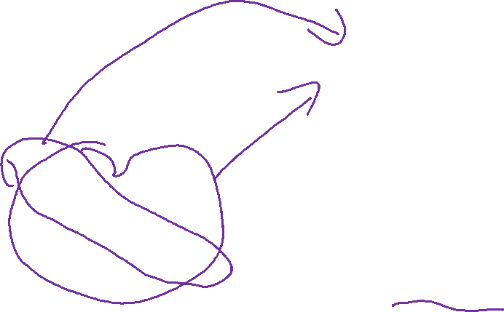
Accuracy
$$\frac{TP+TN}{TP+FP+FN+TN}$$
Accuracy measures fraction of correct decisions.
Estimate of $P\left[D=Y\right]$
Truth
1
0
Decision
1
True Positive
False Positive
0
False Negative
True Negative

Slide 7
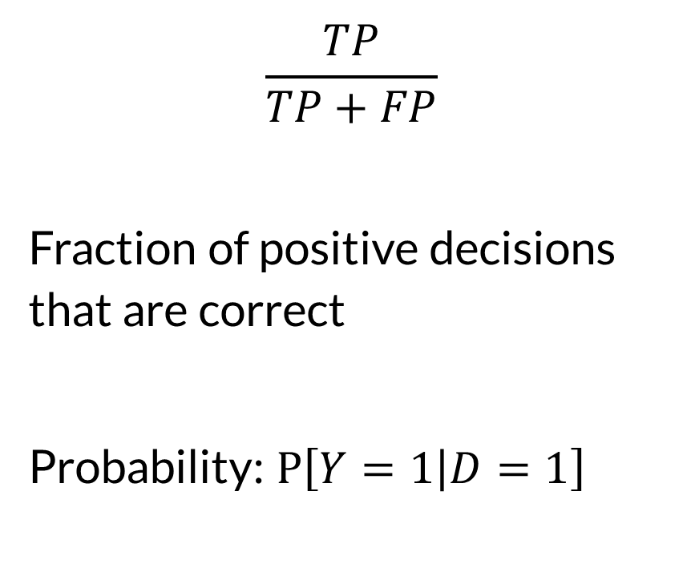
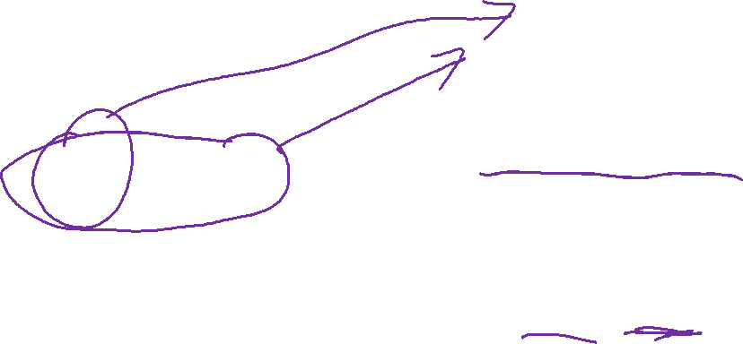
Precision
$$\frac{TP}{TP+FP}$$
Fraction of positive decisions that are correct
Probability: $P\left[Y=1 | D=1\right]$
Truth
1
0
Decision
1
True Positive
False Positive
0
False Negative
True Negative

Slide 8
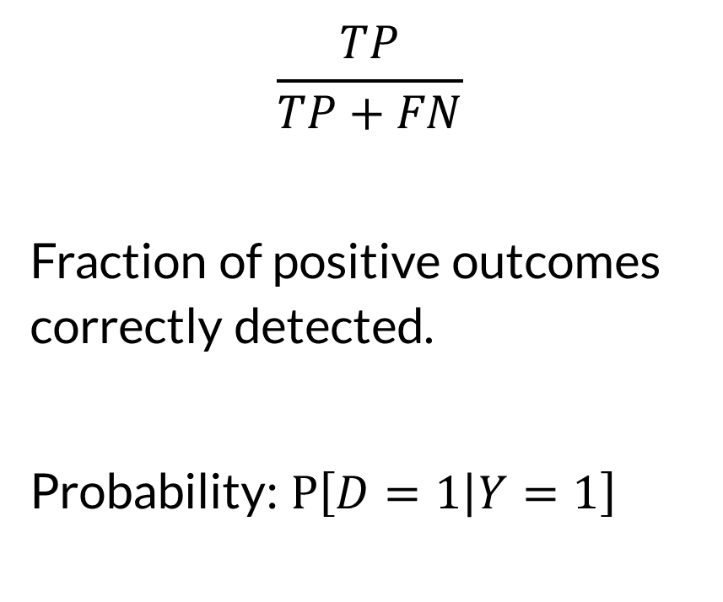
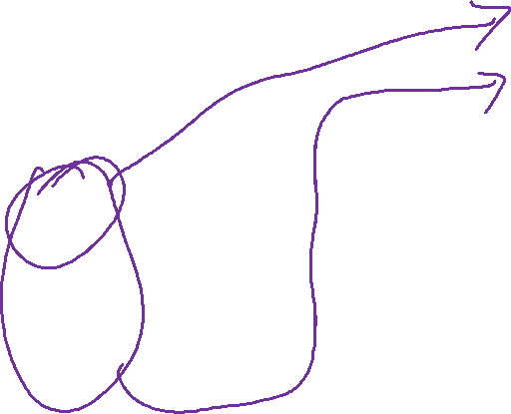
Recall
$$\frac{TP}{TP+FN}$$
Fraction of positive outcomes correctly detected.
Probability: $P\left[D=1 | Y=1\right]$
Truth
1
0
Decision
1
True Positive
False Positive
0
False Negative
True Negative

Slide 9
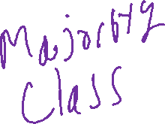
Why Not Just Use Accuracy?
Not all errors have equal costs
False positive in a preliminary cancer screen: run another test
False negative: miss a life-threatening illness
Imbalanced classes skew accuracy
90% cases positive: always guessing 1 has 90% accuracy
Confusion: any of these metrics sometimes called accuracy metrics.

Slide 10

Precision [P(Y=1|D=1)]
Captures correctness of positive decisions
When we say spam, is it spam?
When we say fraud, is it fraud?
When we say good loan, is it a good loan?
Also called Positive Predictive Value
Useful when FP cost is high, getting it right is important
Sensitive to prevalence of positive outcomes

Slide 11
Recall [P(D=1|Y=1)]
Captures detection rate of true outcomes
If it’s spam, do we find it?
If it’s fraud, do we find it?
If it’s cancer, do we find it?
Also called Sensitivity or True Positive Rate
Crucial when FN (missed detection) cost is high

Slide 12
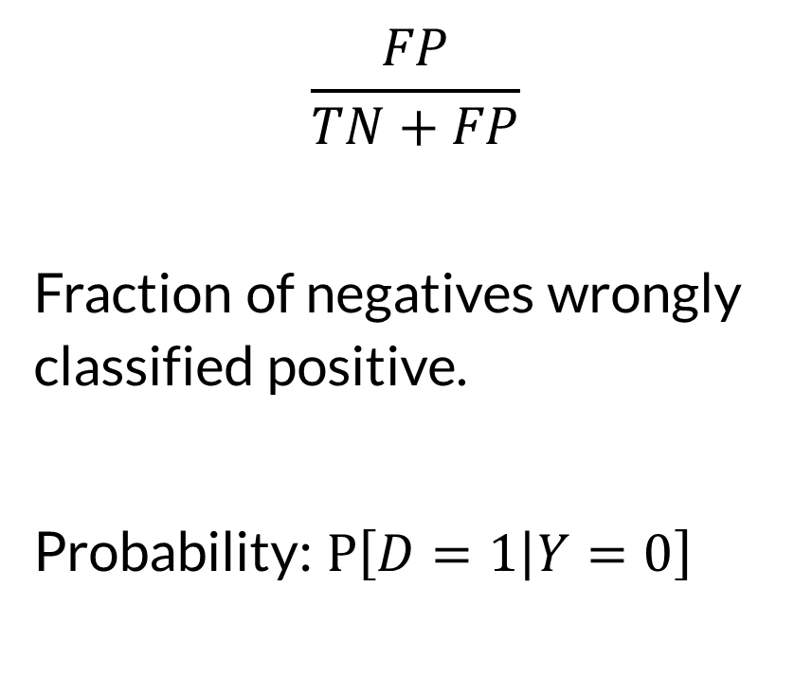
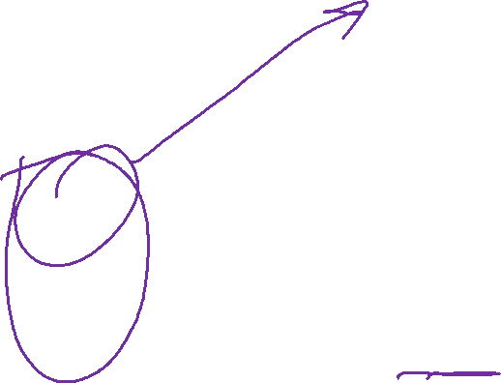
False Positive Rate
$$\frac{FP}{TN+FP}$$
Fraction of negatives wrongly classified positive.
Probability: $P\left[D=1 | Y=0\right]$
Truth
1
0
Decision
1
True Positive
False Positive
0
False Negative
True Negative

Slide 13
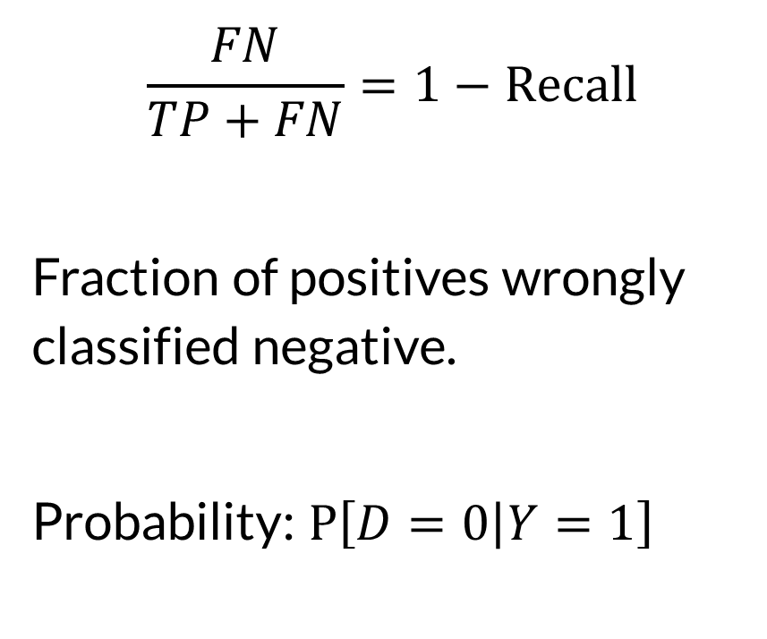
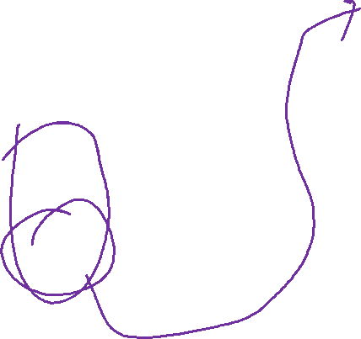
False Negative Rate
$$\frac{FN}{TP+FN}=1−Recall$$
Fraction of positives wrongly classified negative.
Probability: $P\left[D=0 | Y=1\right]$
Truth
1
0
Decision
1
True Positive
False Positive
0
False Negative
True Negative

Slide 14
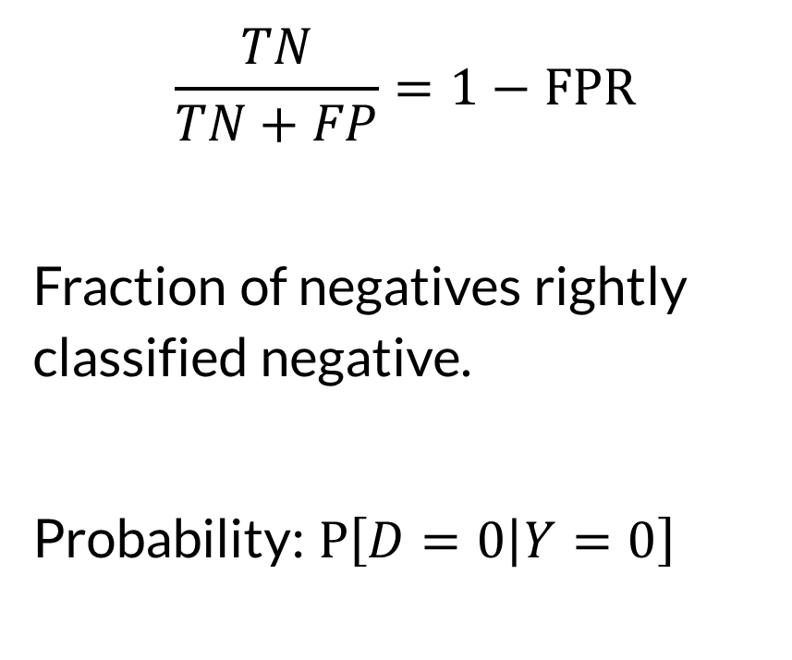

Specificity
$$\frac{TN}{TN+FP}=1−FPR$$
Fraction of negatives rightly classified negative.
Probability: $P\left[D=0 | Y=0\right]$
Truth
1
0
Decision
1
True Positive
False Positive
0
False Negative
True Negative

Slide 15
Metrics
We can derive many metrics from the confusion matrix
Metrics reflect different needs and consequences
Metrics reflect different stakeholder perspectives
FPR: how likely am I to be falsely accused?

Slide 16

Wrapping Up
The confusion matrix categorizes classification results and errors.
Ratios of various counts produce metrics for classifier accuracy.
Photo by Jon Tyson on Unsplash

